Slide 1
UNIT 5

Slide 2
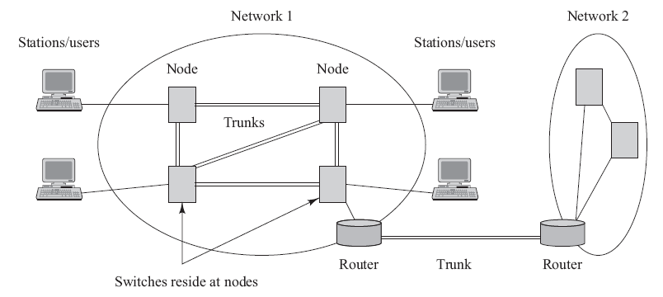
Network Terminology
Stations are devices that network subscribers use to communicate.
A network is a collection of interconnected stations.
A node is a point where one or more communication lines terminate.
A trunk is a transmission line that supports large traffic loads.
The topology is the logical manner in which nodes are linked together by information transmitting channels to form a network.

Slide 3
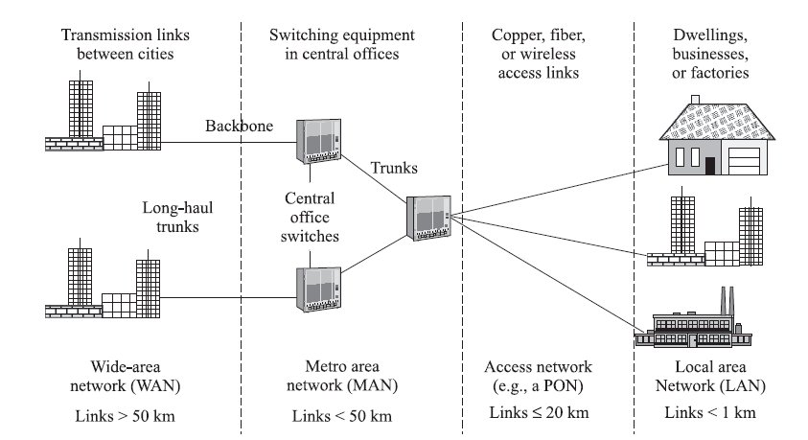
Segments of a Public Network
A local area network interconnects users in a large room or work area, a department, a home, a building, an office or factory complex, or a group of buildings.
A campus network interconnects a several LANs in a localized area.
A metro network interconnects facilities ranging from buildings located in several city blocks to an entire city and the metropolitan area surrounding it.
An access network encompasses connections that extend from a centralized switching facility to individual businesses, organizations, and homes.

Slide 4
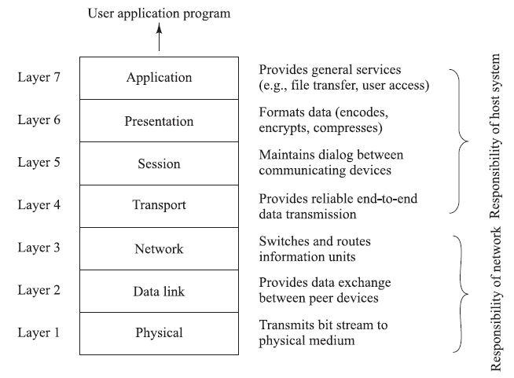
Protocol Stack Model
The physical layer refers to a physical transmission medium
The data link layer establishes, maintains, and releases links that directly connect two nodes
The function of the network layer is to deliver data packets from source to destination across multiple network links.

Slide 5
Network Layering Concept
Network architecture: The general physical arrangement and operational characteristics of communicating equipment together with a common set of communication protocols
Protocol: A set of rules and conventions that governs the generation, formatting, control, exchange, and interpretation of information sent through a telecommunication network or that is stored in a database
Protocol stack: Subdivides a protocol into a number of individual layers of manageable and comprehensible size
  The lower layers govern the communication facilities.
  The upper layers support user applications by structuring and organizing data for the needs of the user.

Slide 6
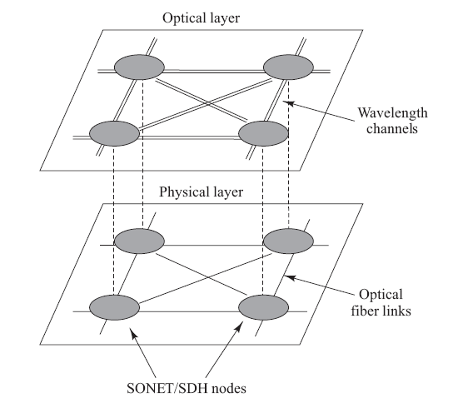
Optical Layer
The optical layer is a wavelength-based concept and lies just above the physical layer
The physical layer provides a physical connection between two nodes
The optical layer provides light path services over that link
The optical layer processes include wavelength multiplexing, adding and dropping wavelengths, and support of optical switching

Slide 7
Synchronous Optical Networks
SONET is the TDM optical network standard for North America
SONET is called Synchronous Digital Hierarchy (SDH) in the rest of the world
SONET is the basic phycal layer standard
Other data types such as ATM and IP can be transmitted over SONET
OC-1 consists of 810 bytes over 125 us; OC-n consists of 810n bytes over 125 us
Linear multiplexing and de-multiplexing is possible with Add-Drop-Multiplexers

Slide 8
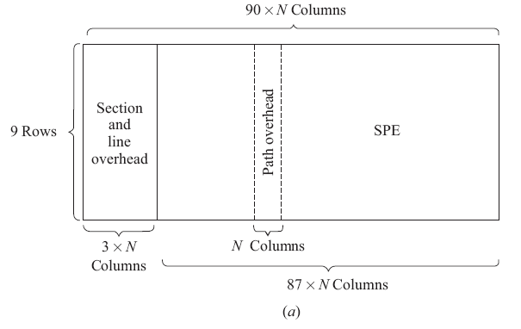
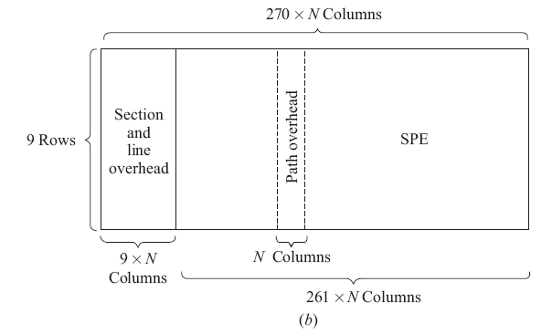
SONET/SDH
The SONET/SDH standards enable the interconnection of fiber optic transmission equipment from various vendors through multiple-owner trunk networks.
The basic transmission bit rate of the basic SONET signal is
In SDH the basic rate is 155.52 Mb/s.
Basic formats of (a) an STS-N SONET frame and (b) an STM-N SDH frame

Slide 9
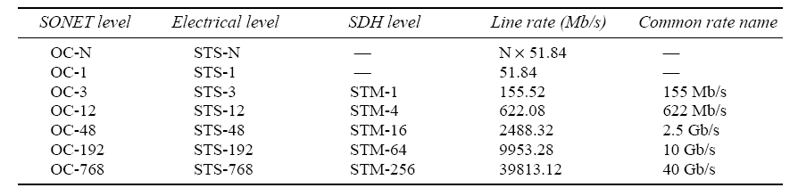
Common values of OC-N and STM-N
OC stands for optical carrier. It has become common to refer to SONET links as OC-N links.
The basic SDH rate is 155.52 Mb/s and is called the synchronous transport module—level 1 (STM-1).

Slide 10
SONET Add Drop Multiplexers
SONET ADM is a fully synchronous, byte oriented device, that can be used add/drop OC sub-channels within an OC-N signal
Ex: OC-3 and OC-12 signals can be individually added/dropped from an OC-48 carrier
Not to be confused with Wavelength ADM
Notes:
13

Slide 11
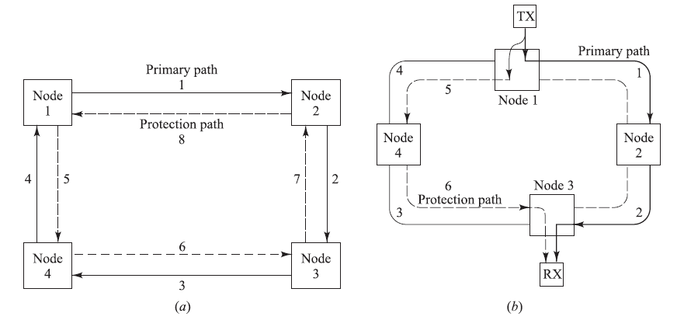
SONET/SDH Rings
SONET and SDH can be configured as either a ring or mesh architecture
SONET/SDH rings are self-healing rings because the traffic flowing along a certain path can be switched automatically to an alternate or standby path following failure or degradation of the link segment
Two popular SONET and SDH networks:
  2-fiber, unidirectional, path-switched ring (2-fiber UPSR)
  2-fiber or 4-fiber, bidirectional, line-switched ring (2-fiber or 4-fiber BLSR)
Generic 2-fiber UPSR with a counter-rotating
protection path

Slide 12
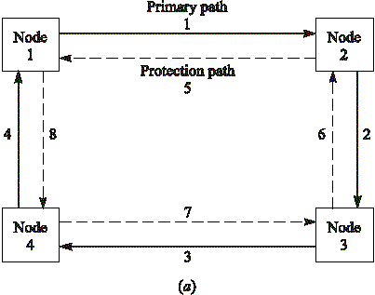
2-Fiber UPSR Basics
Node 1-2
OC-3
Node 2-4; OC-3
Ex: Total capacity OC-12 may be divided to
four OC-3 streams, the OC-3 is called a path here
Notes:
7

Slide 13








2-Fiber UPSR Protection
Rx compares the signals received via the primary and protection paths and picks the best one
Constant protection and automatic switching
Notes:
8

Slide 14
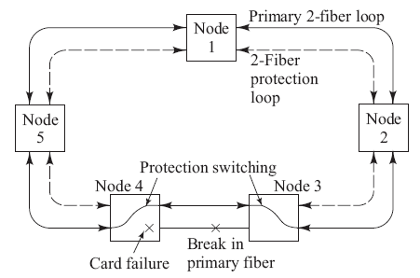
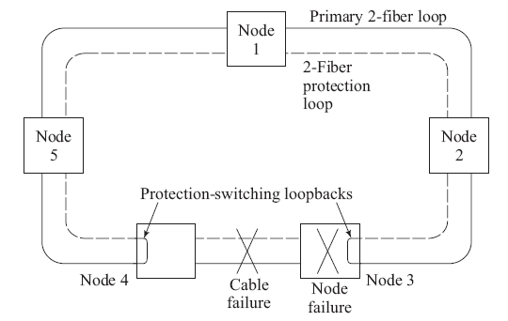
BLSR Recovery from Failure Modes
If a primary-ring device fails in either node 3 or 4, the affected nodes detect a loss-of-signal condition and switch both primary fibers connecting these nodes to the secondary protection pair
If an entire node fails or both the primary and protection fibers in a given span are severed, the adjacent nodes switch the primary-path connections to the protection fibers, in order to loop traffic back to the previous node.

Slide 15




4-Fiber BLSR Basics
All secondary fiber left for protection
Node 1→3; 1p, 2p Node 3→1; 3p, 4p
Notes:
9

Slide 16
BLSR Fiber-Fault Reconfiguration
In case of failure, the secondary fibers between only the affected nodes (3 & 4) are used, the other links remain unaffected
Notes:
10

Slide 17
BLSR Node-Fault Reconfiguration
If both primary and secondary are cut, still the connection is not lost, but both the primary and secondary fibers of the entire ring is occupied
Notes:
11

Slide 18
Generic SONET network
Large National Backbone
City-wide
Local Area
Versatile SONET equipment
are available that support wide
range of configurations, bit rates
and protection schemes
Notes:
12

Slide 19
Passive Optical Networks
In general, there is no O/E conversion between the transmitter and the receiver (one continuous light path) in PON networks
Only passive elements used to configure the network
Power budget and rise time calculations has to be done from end-to-end
There are star, bus, ring, mesh & tree topologies
Currently PON Access Networks are deployed widely and the word PON means mainly the access nw.
The PON will still need higher layer protocols (Ethernet/IP etc.) to separate multiple users

Slide 20
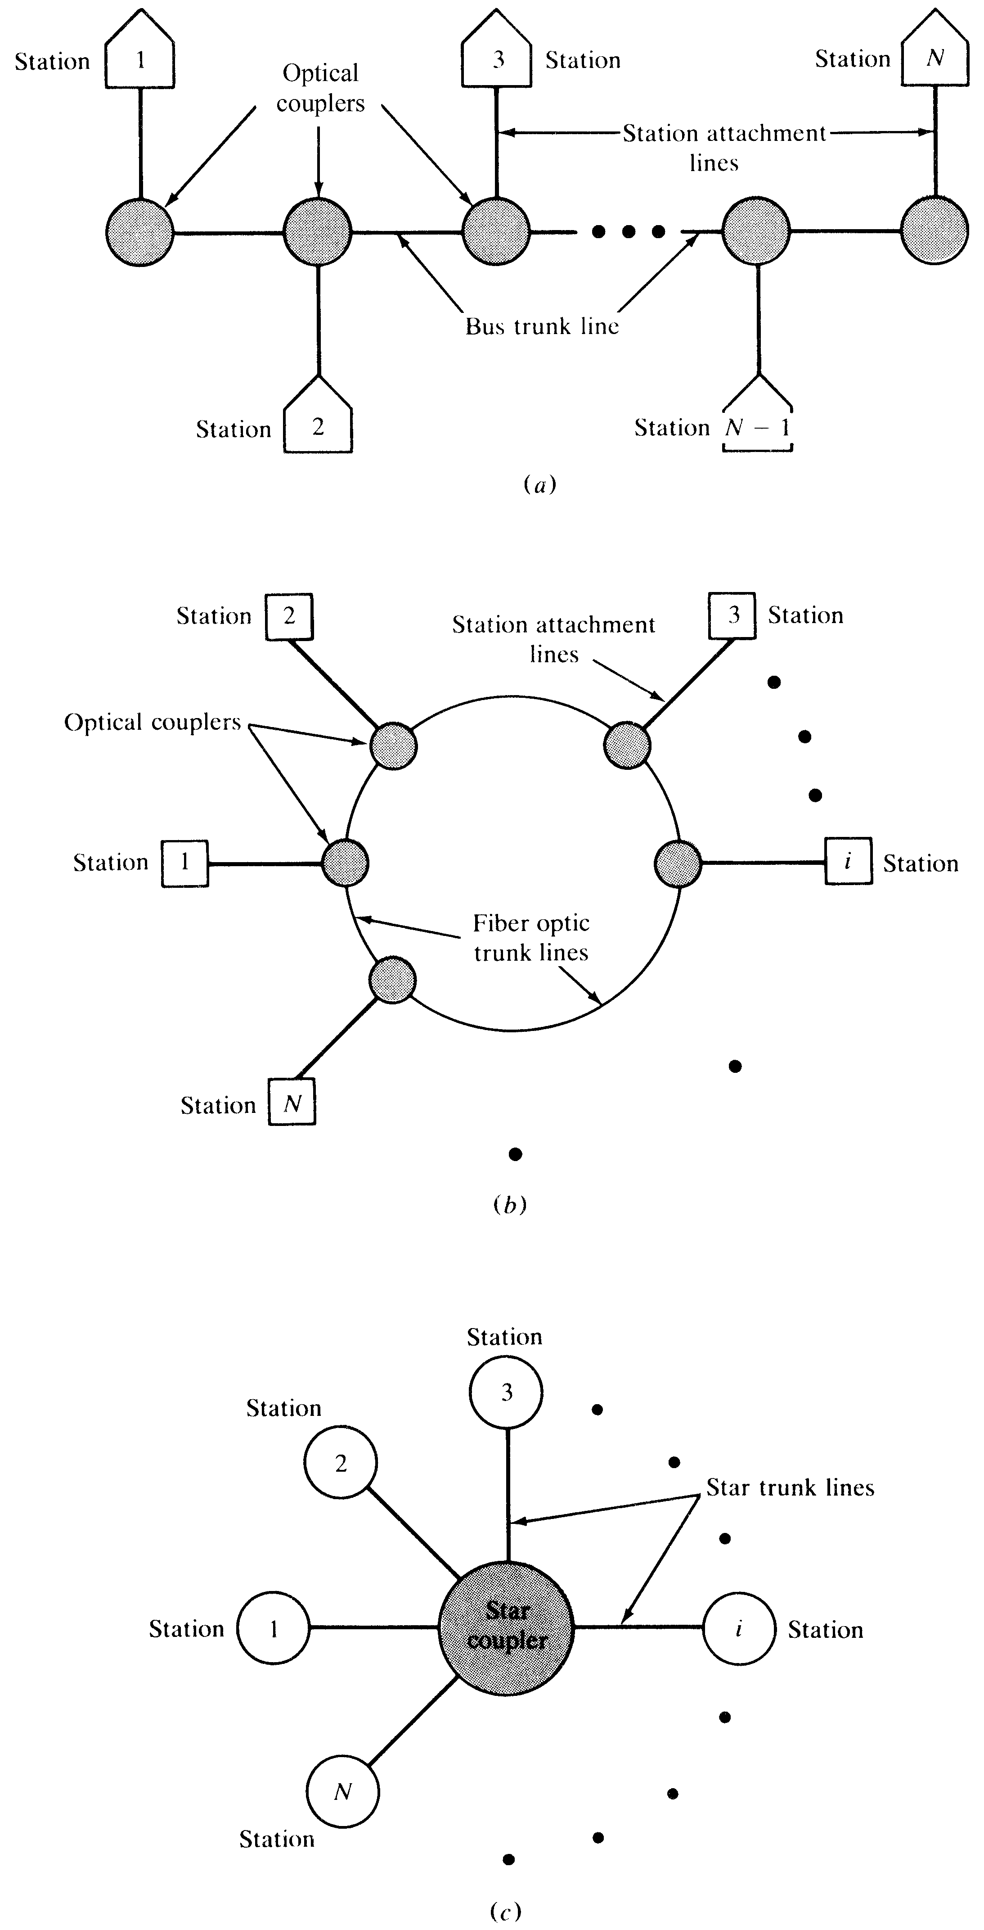
Basic PON Topologies
BUS
RING
STAR
Notes:
1

Slide 21
Star, Tree & Bus Networks
Tree networks are widely deployed in the access front
Tree couplers are similar to star couplers (expansion in only one direction; no splitting in the uplink)
Bus networks are widely used in LANs
Ring networks (folded buses with protection) are widely used in MAN
Designing ring & bus networks is similar

Slide 22
Network Elements of PON
Passive Power Coupler/Splitter: Number of input/output ports and the power is split in different ratios.
  Ex: 2X2 3-dB coupler; 80/20 coupler
Star Coupler: Splits the incoming power into number of outputs in a star network
Add/Drop Bus Coupler: Add or drop light wave to/from an optical bus
All Optical Switch: Divert the incoming light wave into a particular output

Slide 23
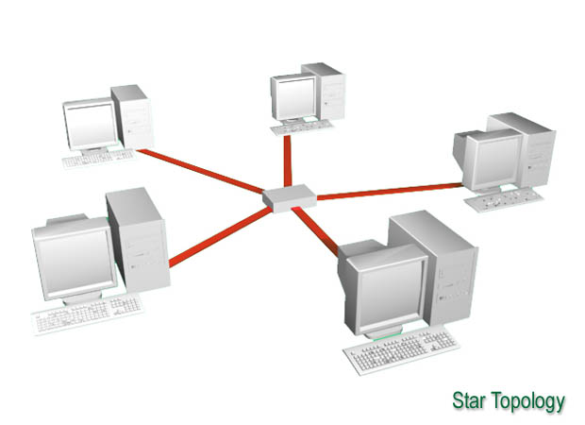
Star Network
Power Budget:
Worst case power budget need to be satisfied
P_{s}-P_{r} = 2l_{c} + α(L₁+L₂) + Excess Loss + 10 Log N + System Margin

Slide 24
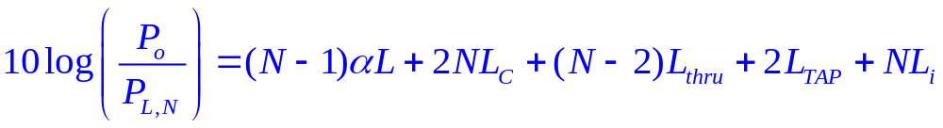
Linear Bus Network
Ex. 12.1
Notes:
3

Slide 25
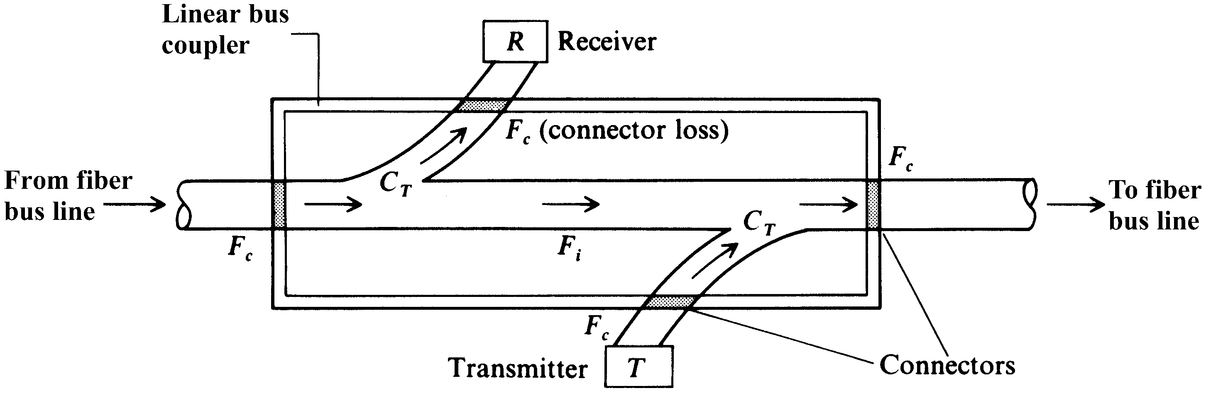
Add-Drop Bus-Coupler Losses
Connector loss (L_{c}) = 10Log (1-F_{c})
Tap loss (L_{tap}) = -10 Log (C_{T})
Throughput loss (L_{th}) = -20 Log (1-C_{T})
Intrinsic loss (L_{i}) = -10 Log (1-F_{i})
Notes:
2

Slide 26
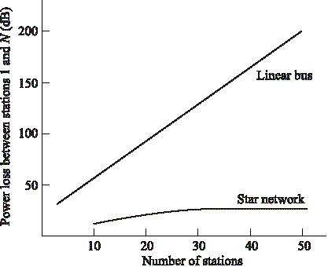
Linear Bus versus Star Network
The loss linearly increases with N in bus networks while it is almost constant in star networks (Log(N))
Notes:
4

Slide 27
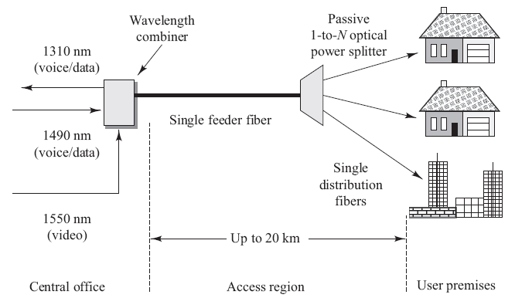
Passive Optical Networks (PONs)
A passive optical network (PON) uses CWDM over a single bidirectional optical fiber.
Only passive optical components guide traffic from the central office to the customer premises and back to the central office.
  In the central office, combined data and digitized voice are sent downstream to customers by using a 1490-nm wavelength.
  The upstream (customer to central office) uses a 1310-nm wavelength.
  Video services are sent downstream using a 1550-nm wavelength.

Slide 28
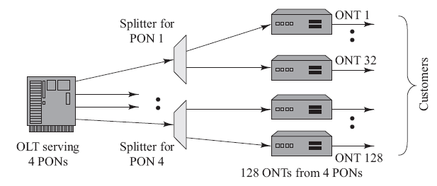
Active PON Modules
The optical line termination (OLT) is located in a central office and controls the bidirectional flow of information across the network.
An optical network termination (ONT) is located directly at the customer premises.
  The ONT provides an optical connection to the PON on the upstream side and to interface electrically to the local customer equipment.
An optical network unit (ONU) is similar to an ONT, but is located near the customer and is housed in an outdoor equipment shelter.

Slide 29
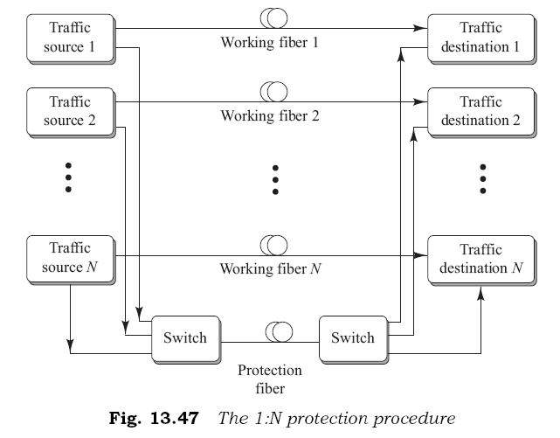
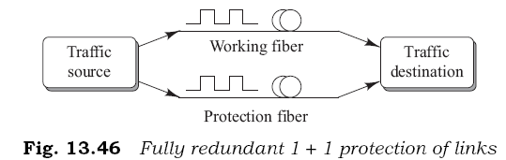
PON Protection Methods
PON failure protection mechanisms include a fully redundant 1 + 1 protection and a partially redundant 1:N protection.

Slide 30
WDM Networks
Single fiber transmits multiple wavelengths → WDM Networks
One entire wavelength (with all the data) can be switched/routed
This adds another dimension; the Optical Layer
Wavelength converters/cross connectors; all optical networks
Note protocol independence

Slide 31
Basic WDM PON Architectures
Broadcast and Select: employs passive optical stars or buses for local networks applications
  Single hop networks
  Multi hop networks
Wavelength Routing: employs advanced wavelength routing techniques
  Enable wavelength reuse
  Increases capacity

Slide 32
Single hop broadcast and select WDM
Star
Bus
Each Tx transmits at a different fixed wavelength
Each receiver receives all the wavelengths, but selects (decodes) only the desired wavelength
Multicast or broadcast services are supported
Dynamic coordination between the TX & RX and tunable filters at the receivers are required
Notes:
15

Slide 33




A Single-hop Multicast WDM Network
Multiple receivers may be listening to the same
wavelength simultaneously
The drawback in single hop WDM networks,
Number of nodes = Number of wavelengths
Notes:
16

Slide 34
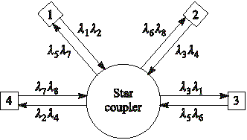
WDM Multi-hop Architecture
Four node broadcast and select multihop network
Each node transmits at fixed set of wavelengths and receive fixed set of wavelengths
Multiple hops required depending on destination
Ex. Node1 to Node2: N1→N3 (λ1), N3→N2 (λ6)
No tunable filters required but throughput is less
Notes:
17

Slide 35
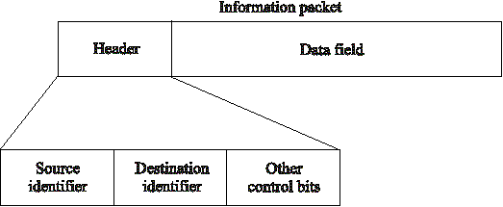
Data Packet
In multihop networks, the source and destination information is embedded in the header
These packets may travel asynchronously (Ex. ATM)
Notes:
18

Slide 36




Shuffle Net
Shuffle Net a popular multihop topology
N_{λ} = (# of nodes) X (λper node)
Max. # of hops = 2(#of-columns) –1
(-) Large # of λ’s
(-) High splitting loss
Ex: A two column shuffle net
Max. 2 X 2 - 1= 3 hops
between any two nodes
Notes:
19

Slide 37








Wavelength Routing
The limitation is overcome by:
  λ reuse,
  λ routing and
  λ conversion
As long as the logical paths between nodes do not overlap they can use the same λ
Most long haul networks use wavelength routing
WL Routing requires optical switches, cross connects etc.
Notes:
20

Slide 38
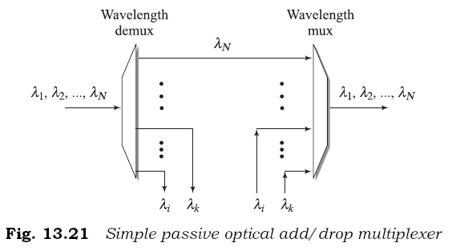
Optical Add/Drop Multiplexing
An optical add/drop multiplexer (OADM) allows the insertion or extraction of one or more wavelengths from a fiber at a network node.
Most OADMs are constructed using WDM elements such as a series of dielectric thin-film filters, an AWG, a set of liquid crystal devices, or a series of fiber Bragg gratings used in conjunction with optical circulators.
The OADM architecture depends on factors such as the number of wavelengths to be dropped/added, the OADM modularity for upgrading flexibility, and what groupings of wavelengths should be processed.

Slide 39
Reconfigurable OADM (ROADM)
ROADMs can be reconfigured by a network operator within minutes from a remote network-management console.
ROADM architectures include wavelength blockers, arrays of small switches, and wavelength-selective switches.
ROADM features:
  Wavelength dependence. When a ROADM is independent of wavelength, it is colorless or has colorless ports.
  ROADM degree is the number of bidirectional multiwavelength interfaces the device supports. Example: A degree-2 ROADM has 2 bidirectional WDM interfaces and a degree-4 ROADM supports 4 bidirectional WDM interfaces.
  Express channels allow a selected set of wavelengths to pass through the node without the need for OEO conversion.

Slide 40
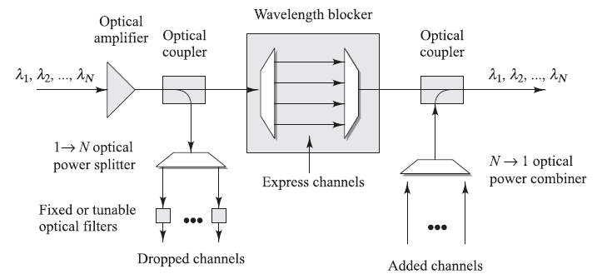
Wavelength Blocker Configuration
The simplest ROADM configuration uses a broadcast-and-select approach:

Slide 41
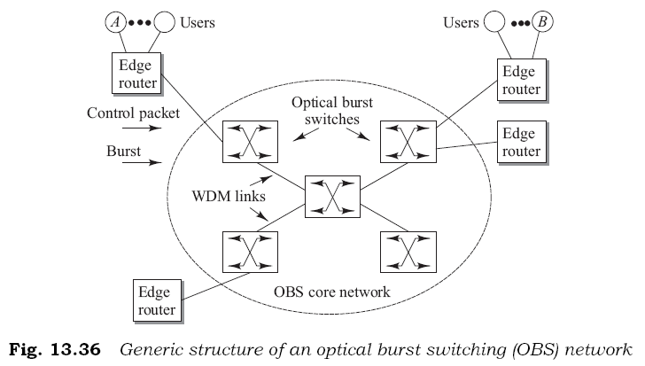
Optical Burst Switching
Optical burst switching provides an efficient solution for sending high-speed bursty traffic over WDM networks.
Bursty traffic has long idle times between the busy periods in which a large number of packets arrive from users.

Slide 42
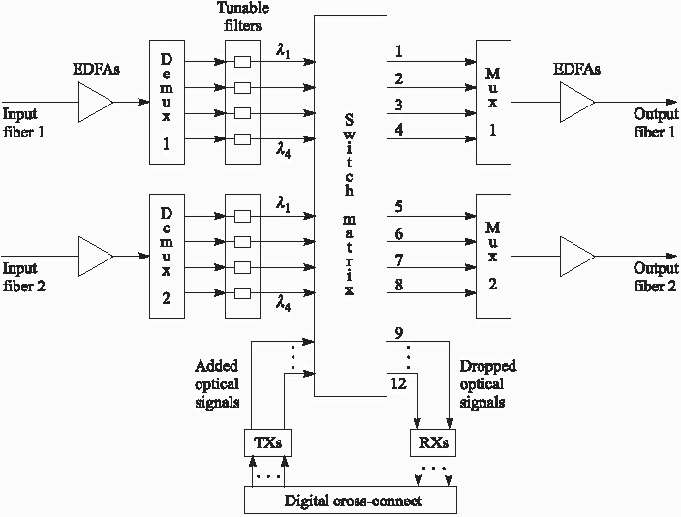
A 12X12 Optical Cross-Connect (OXC)
Incoming wavelengths can be dropped or routed to any desired output

Slide 43
Optical Cross Connects (OXC)
Works on the optical domain
Can route high capacity wavelengths
Switch matrix is controlled electronically
Incoming wavelengths are routed either to desired output (ports 1-8) or dropped (9-12)
Local wavelengths can be added
What happens when both incoming fibers have a same wavelength? (contention)

Slide 44
Ex: 4X4 Optical cross-connect
Wavelength switches are electronically configured
Wavelength conversion to avoid contention
Notes:
22

Slide 45
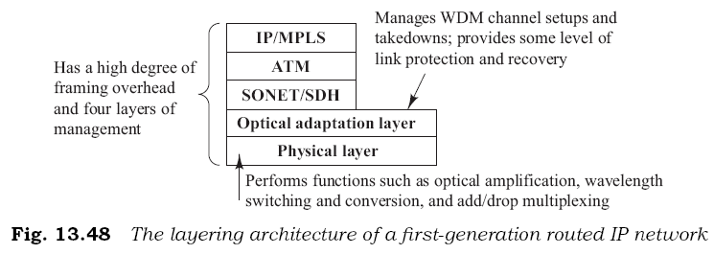
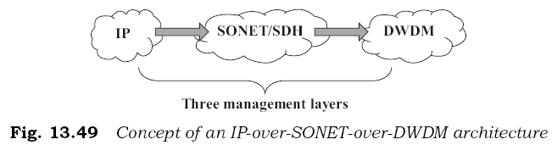
IP over DWDM
Early IP networks had redundant management functions in each layer, so this layering method was not efficient for transporting IP traffic.
An IP-SONET-DWDM architecture using Multiprotocol Label Switching (MPLS) provides for the efficient designation, routing, forwarding, and switching of traffic flows through the network.

Slide 46
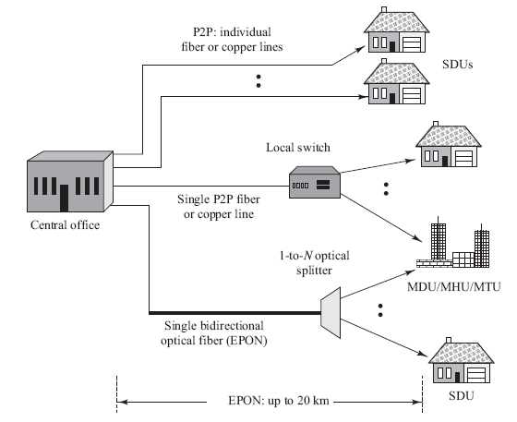
Optical Ethernet
The IEEE has approved the 802.3ah Ethernet in the First Mile (EFM) standard.
The first mile is the network infrastructure that connects business or residential subscribers to the CO of a telecom carrier or a service provider.
Three EFM physical transport schemes are:
Individual point-to-point (P2P) links
A single P2P link to multiple users
A single bidirectional PON

